Slide 1

PROJECT MANAGEMENT AND MAINTENCE
Under the guidance of
Dr. J. Albert Mayan, ME, Ph.D.,
by
Hariharan B P
(39110373)
Jagadeesh N
(39110393)
Mohnish Devaraj
(39110636)

Slide 2
Presentation Outline
Introduction
Motivation
Literature survey
Inferences from Literature Survey
Objectives
System Architecture
Description of Software for Implementation
Project Management Plan
References
Q&A

Slide 3
Introduction
This application is a web-based portal that allows the students to register themselves and select their guide for the final year project. This is an in-house project given by the department of CSE.
The students can register their team using email, name, and project details such as project name, project domain, and Project Description.
The students can choose the guide based on the availability of the guide, and the details of their team will be emailed to the student(s) containing the project details via SMTP protocol.
Once the team is registered, the student(s) cannot log in again to avoid duplicates and to change their guide.

Slide 4
Objectives
The Student Project and Guide Registration System is an web based portal.
It can be used by educational institutes or colleges to maintain the projects of students easily.
This Portal allows online submission of student Project details and selection of the guide.
Achieving this objective is difficult using a manual system as the information is scattered, can be redundant and collecting relevant information may be very time consuming.
This Portal will store the details of the students such as student details, Project details, guide selected, guide details.

Slide 5
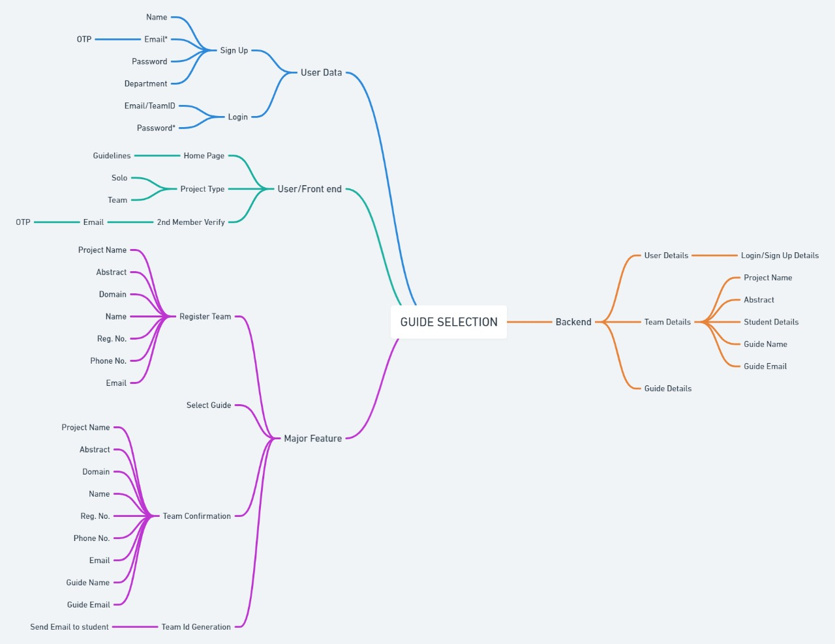
Ideation Map

Slide 6
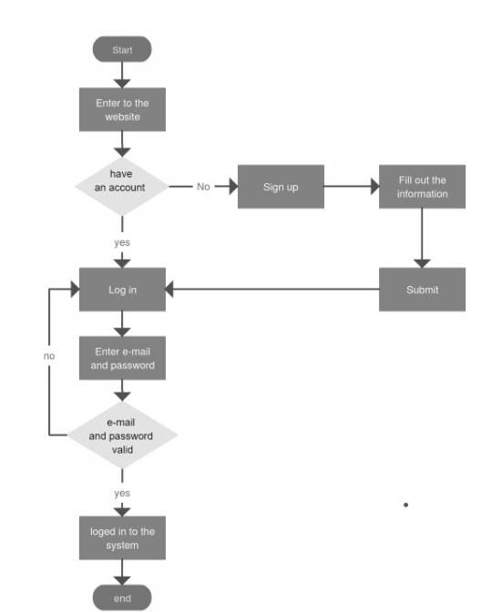

Slide 7
Process for Final year project Registration
Register
Register using Name, email id, password
OTP is generated to the given mail id, and verifies the email id
Login
Login using email id and password
Select the team size
Select the total number of students, one member or two members
If two members, second team member mail id should also be verified using OTP.
Fill the form
Fill the form which consists of Project Title, Project Domain, Project Description, and details of the student(s) such as Name, Email, Registration Number and Mobile Number.

Slide 8
Process for Final year project Registration
Selecting of the Guide
Students need to select the guide
Confirmation Page
This page will consists of all the details filled by the user, which allows the user to check the details entered.
Submission
This is the final page, where the details have been stored in the database.

Slide 9
Description of Software for Implementation
Front-end: HTML 5, CSS 3, Bootstrap, Java Script
Back-end: Django(Python)
Database: Postgres
Hosting: Heroku
Domain: GoDaddy
SSL: Cloudflare

Slide 10
Modules
Psycopg2:- A plugin for connecting backend Django with postgresql database and performing the query operation.
Send_email():- A Django.email plugin to send auto-generated email from the server to the user regarding the status of his/her submission.
Django-Heroku:- A Heroku plugin for connecting the Heroku cloud base with our local Application.
Gunicorn:- Determines what type of Web Application it is i.e. identifies it as WSGI(Web Server Gateway Interface) or ASGI (Asynchronous Server Gateway Interface) and acts as a medium to serve requests from Heroku cloud server to web application in the backend.

Slide 11
Project Management Plan
Planning:
Discussion with dean mam and professors
Designing:
Used Figma for designing
Development:
Used VS code
Testing:
3 Testing were done
Deploying:
Deployed in Heroku, and used GoDaddy for Domain

Slide 12
Project Management Plan
The project registration and guide selection is a module for the final year and it is deployed in Heroku.
We have planned to implement some more modules such as PT-1 and PT-2 for pre-final year students, project registration, guide selection, type selection, and files upload(project documents and ppt) for the pre final year and final year students.
This modules helps in maintaining the projects done by the final and pre-final year students with ease. This makes the job much easier for both the department and students.

Slide 13
Project Management Plan
We are planning to implement a cloud storage to collect all the project documents , ppt and course/internship certifications.
This projects is used by the department to collect the student details, project details, guide details and to check and review the ppt and documentation. The staffs can also give the comments, suggestions and remarks on the project and the students can review it and can work in it.

Slide 14
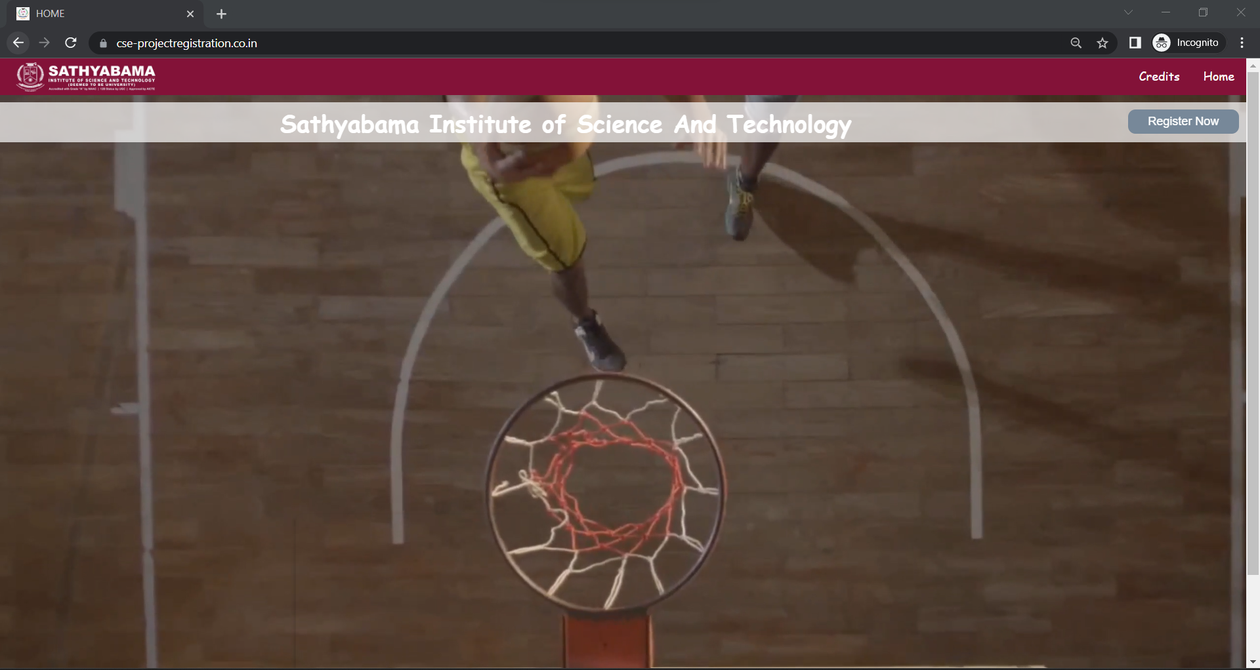
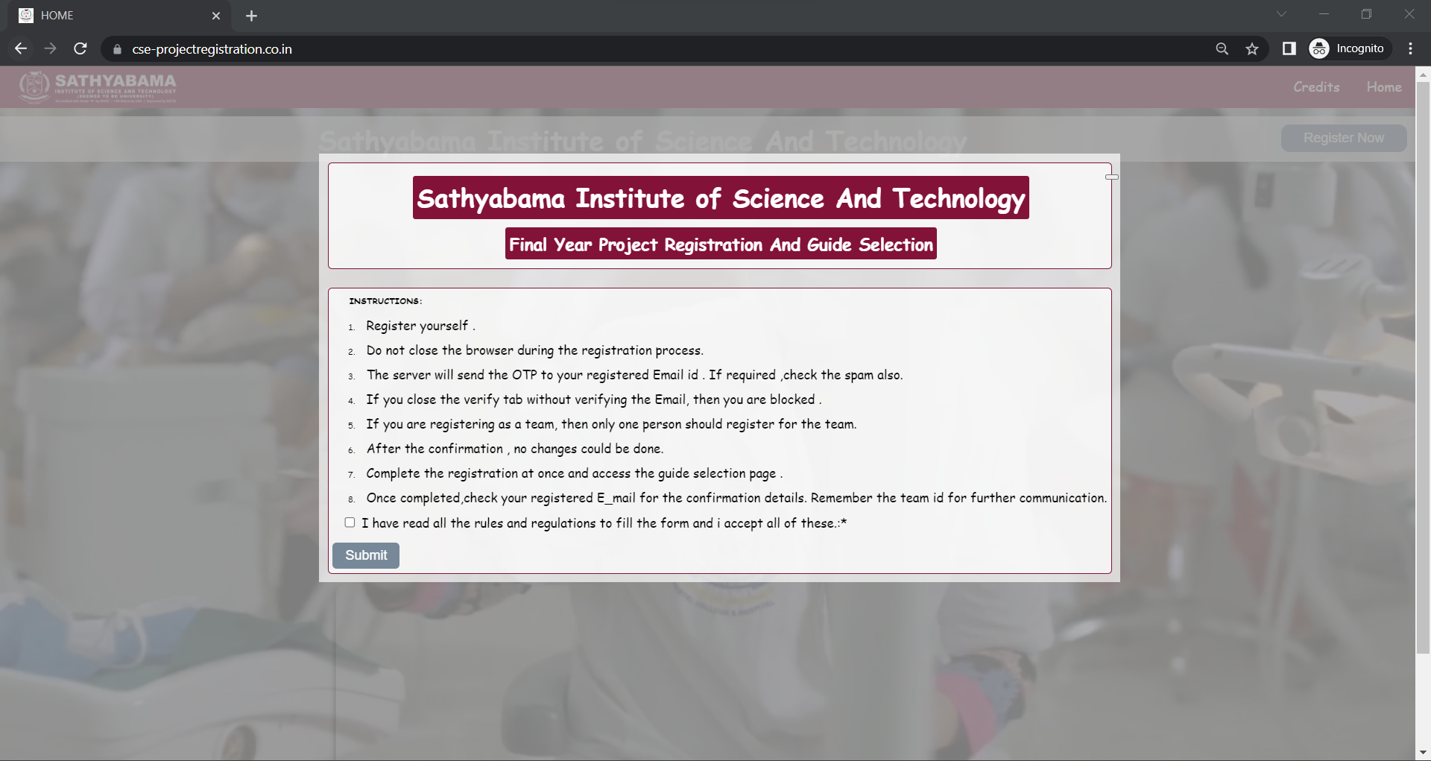
Application Screen shots

Slide 15
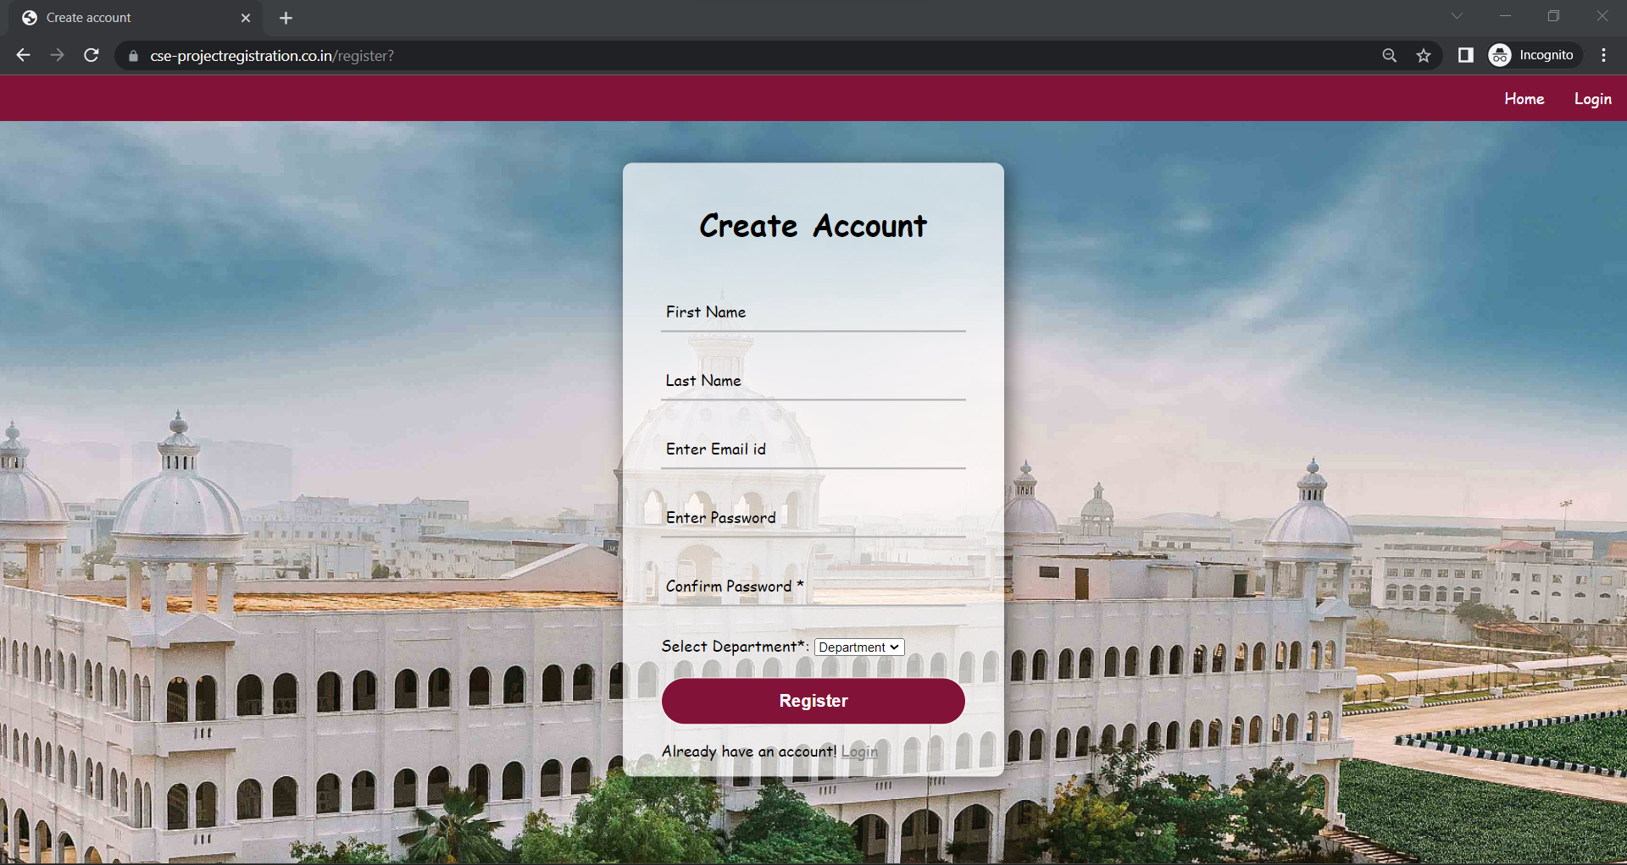
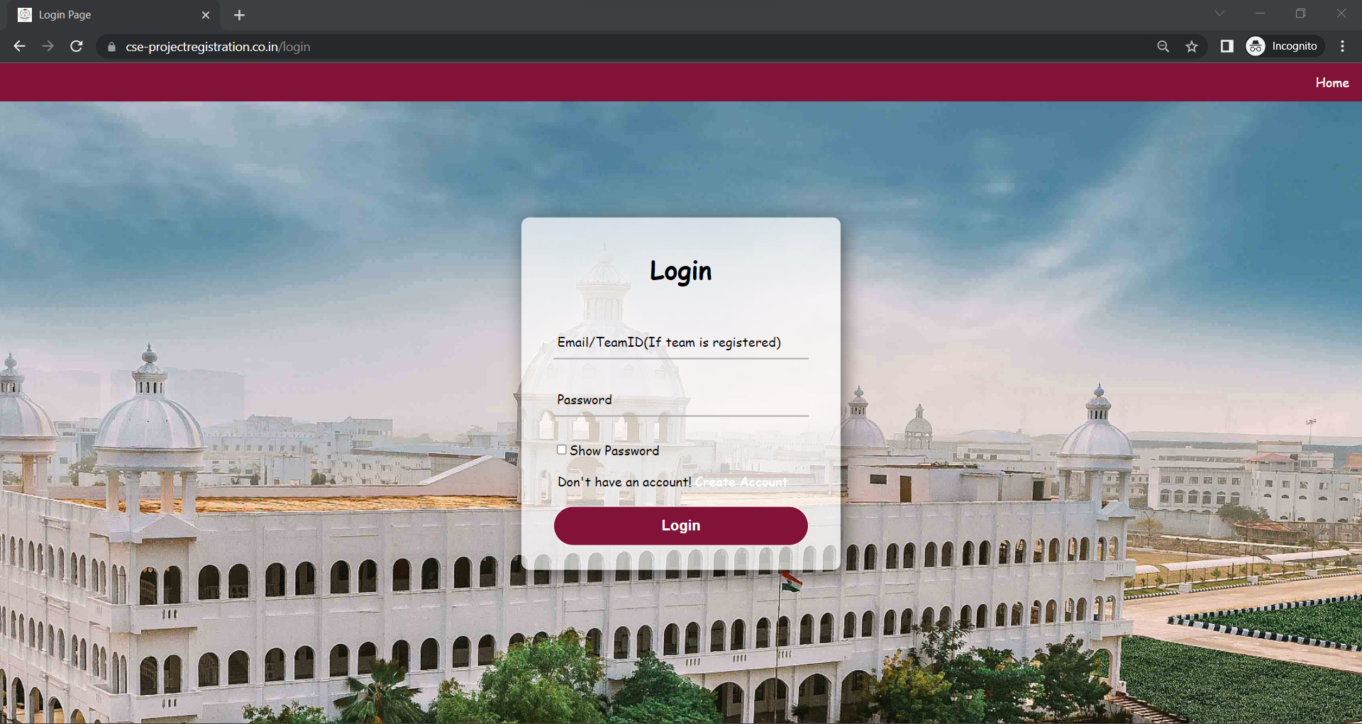
Application Screen shots

Slide 16
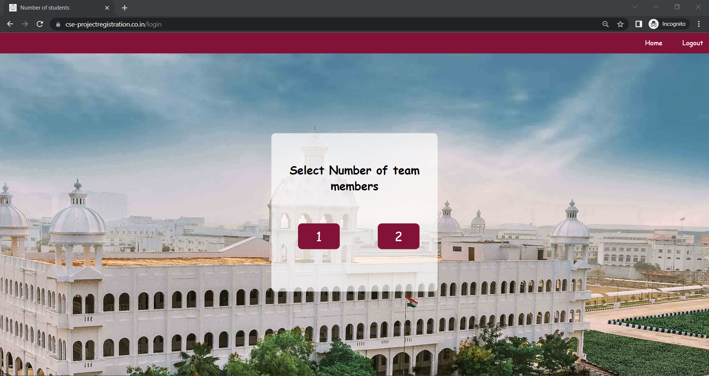
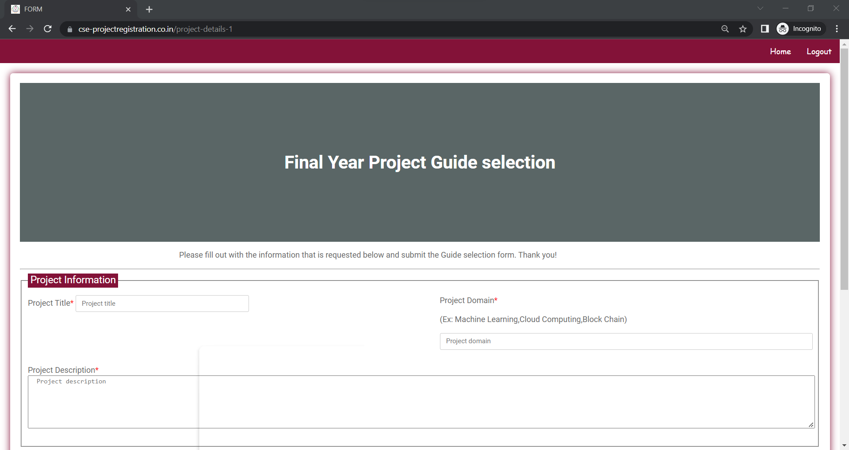
Application Screen shots

Slide 17
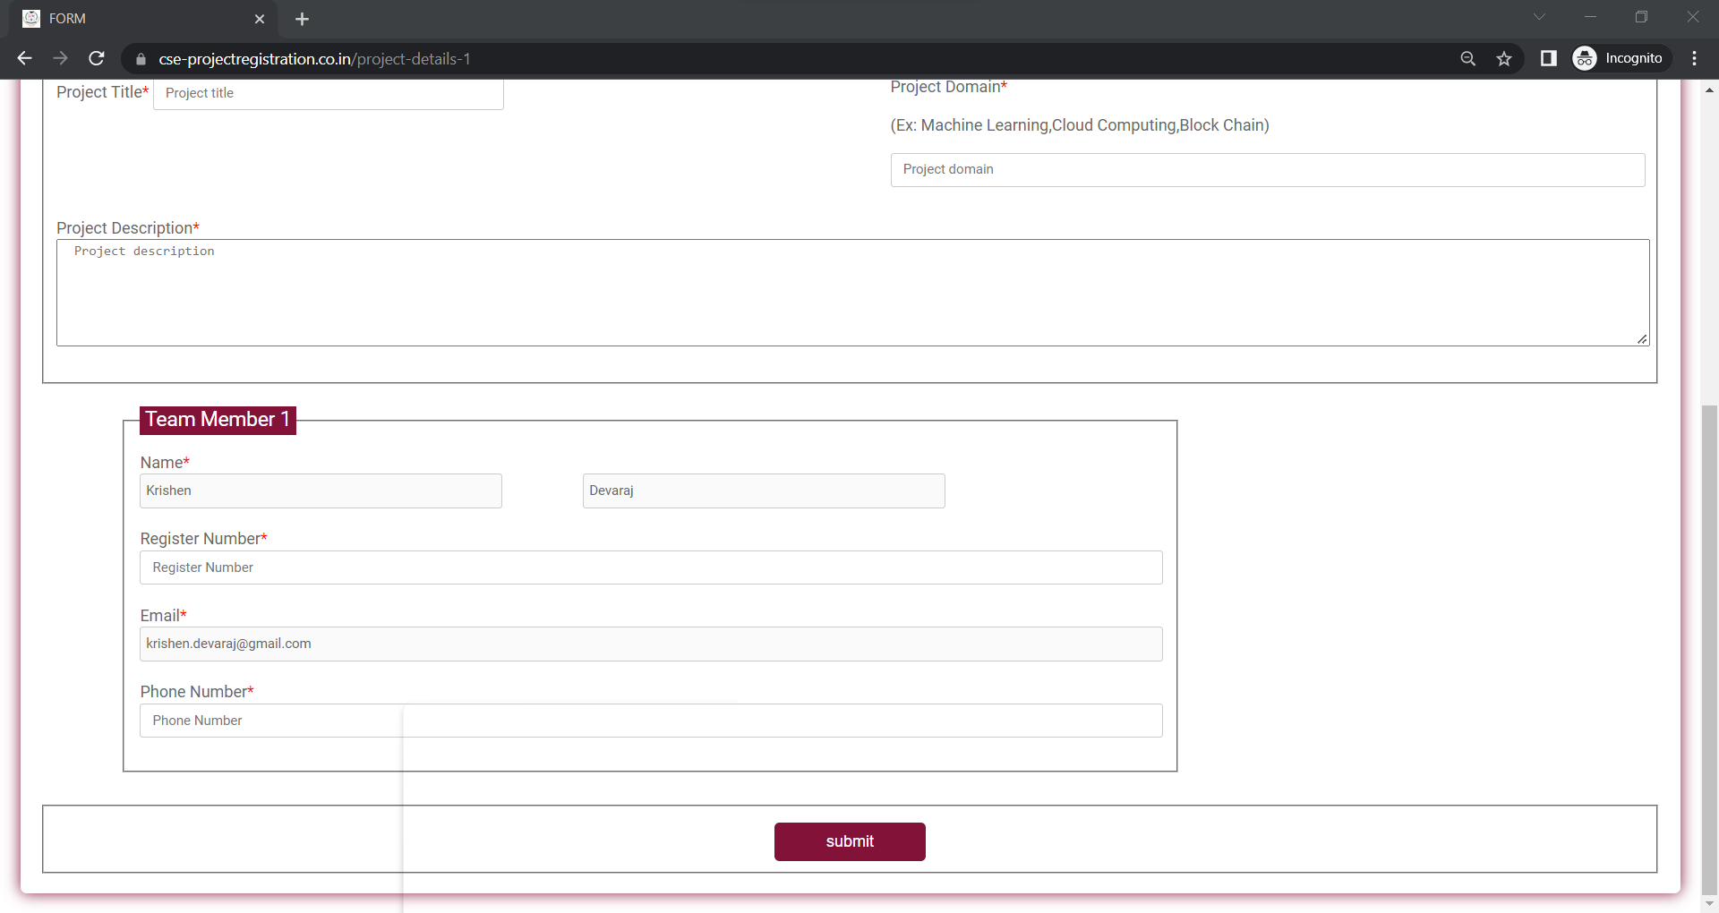
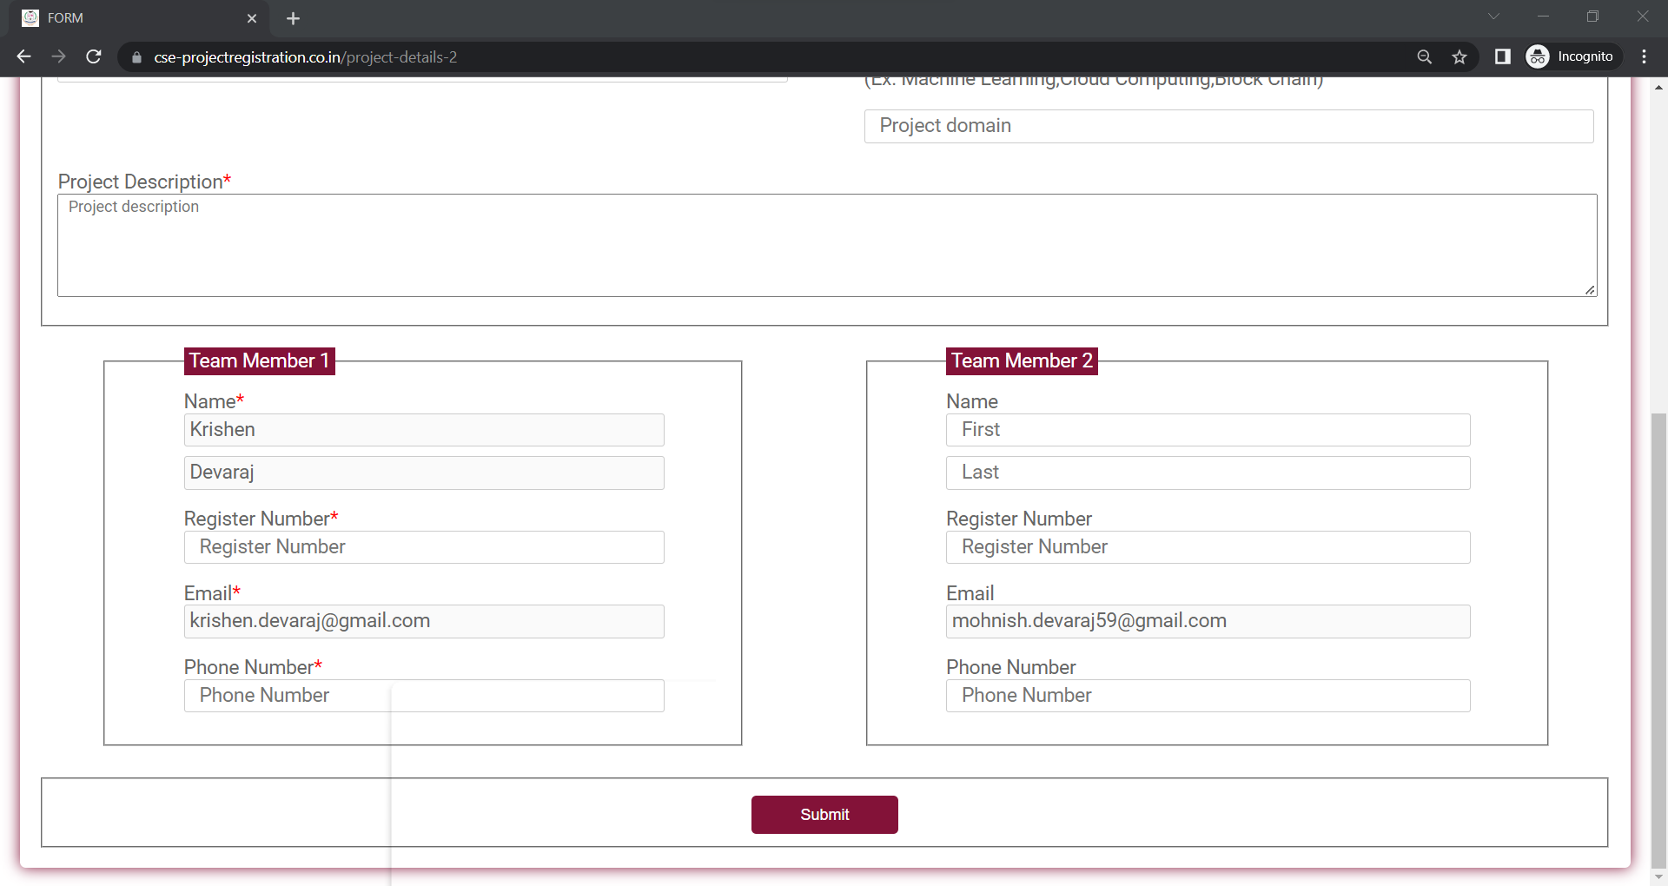
Application Screen shots

Slide 18
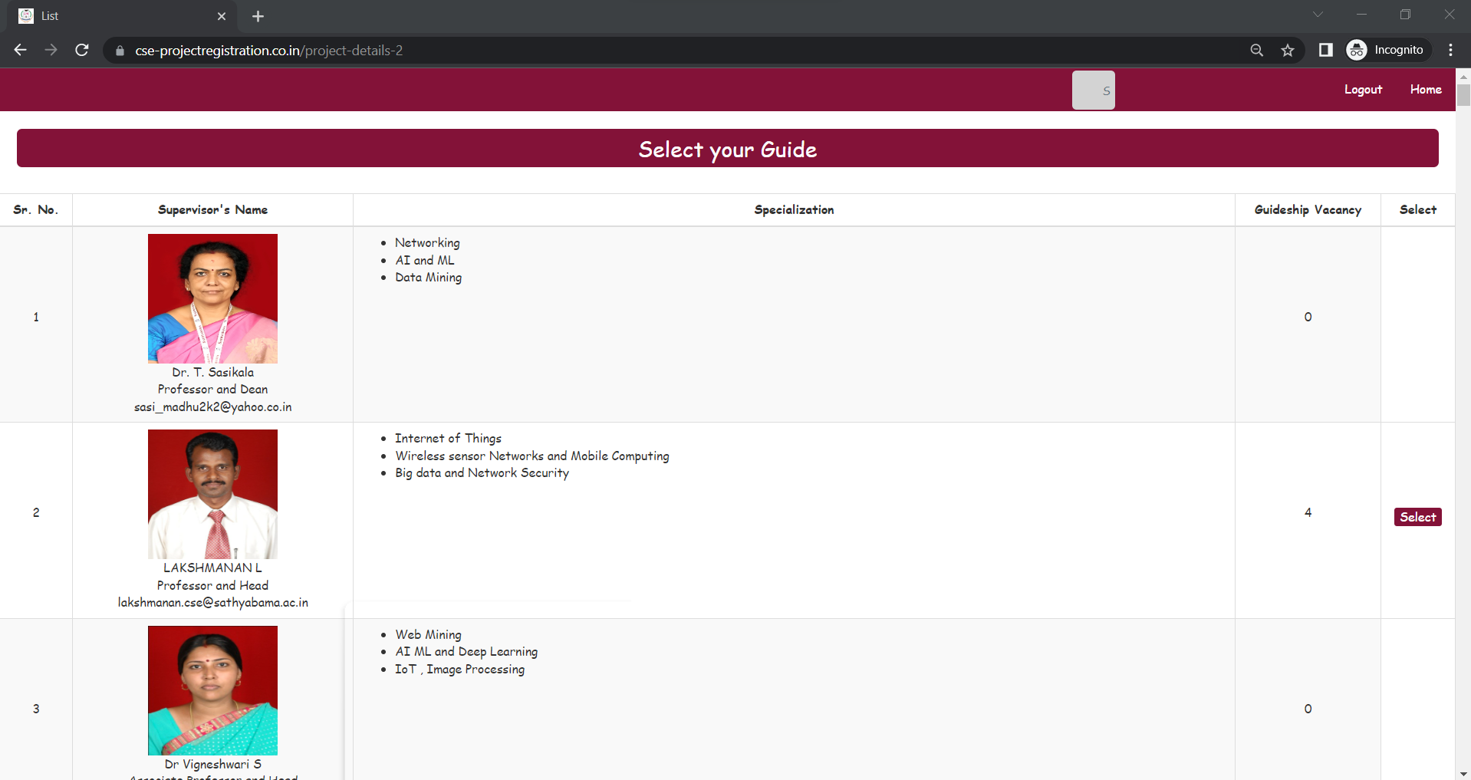
Application Screen shots

Slide 19
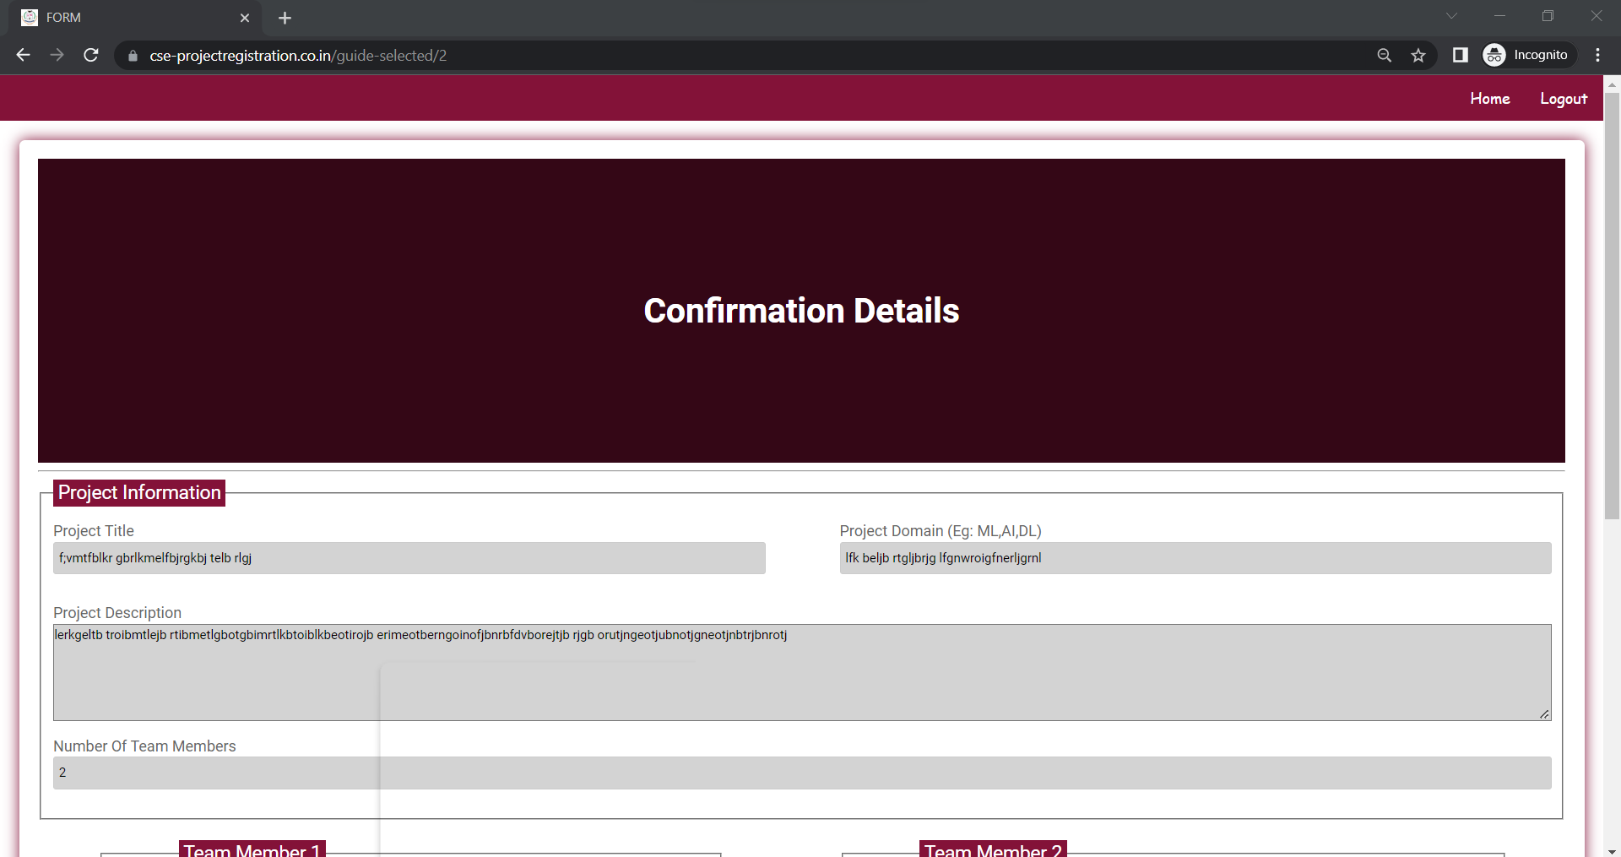
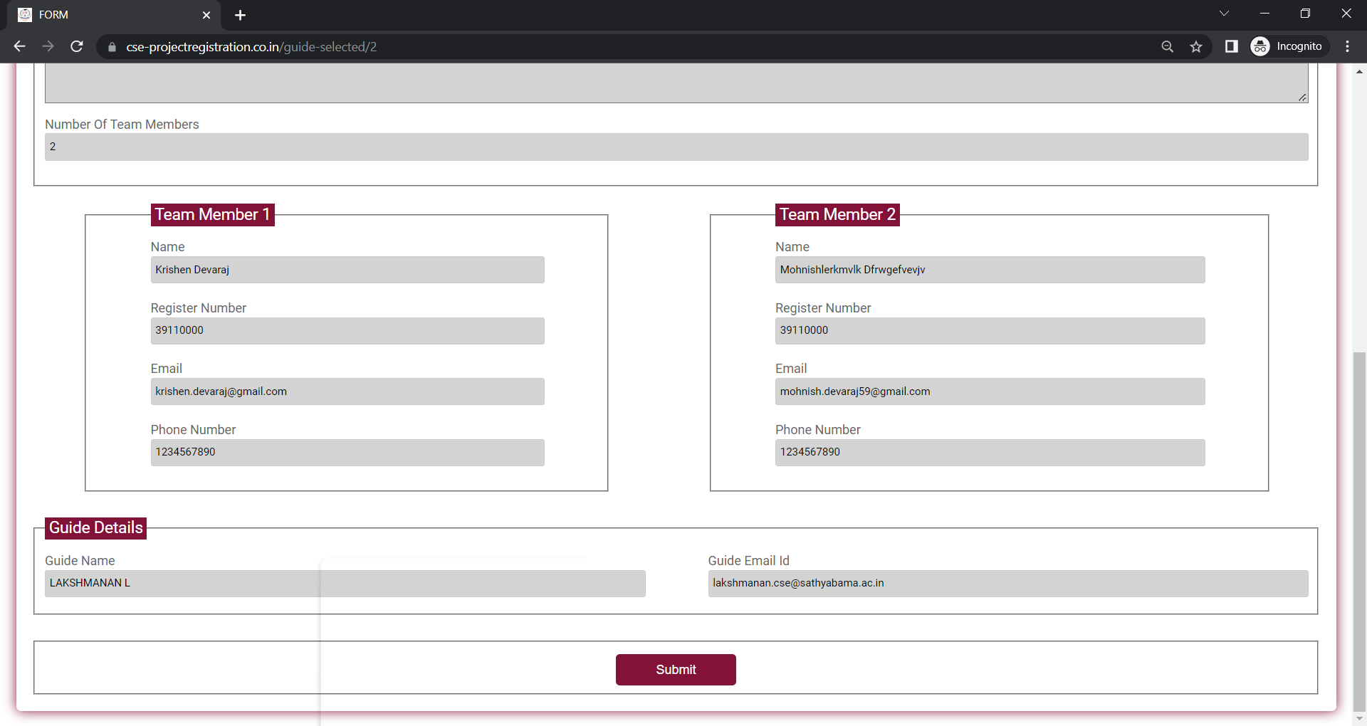
Application Screen shots

Slide 20
THANK YOU
We thank our guide and panel and all technical and non technical staff helped us in achieving this.

